Slide 1
Discrete Strcuture
Lecture 15
Algorithm

Slide 2
ALGORITHM:
The word "algorithm" refers to a step-by-step method for performing
some action. A computer program is, similarly, a set of instructions that are executed
step-by-step for performing some specific task. Algorithm, however, is a more general
term in that the term program refers to a particular programming language.

Slide 3
INFORMATION ABOUT ALGORITHM:
The following information is generally
included when describing algorithms formally:
1.The name of the algorithm, together with a list of input and output variables.
2.A brief description of how the algorithm works.
3.The input variable names, labeled by data type.
4.The statements that make the body of the algorithm, with explanatory comments.
5.The output variable names, labeled by data type.
6.An end statement.

Slide 4
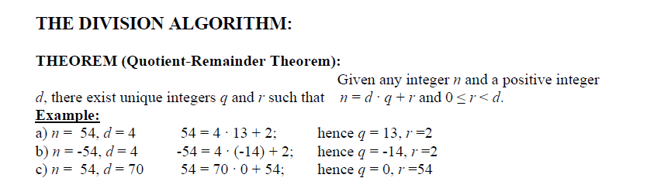

Slide 5
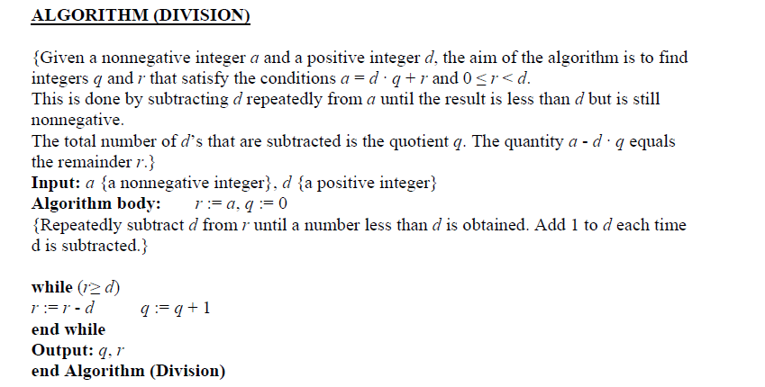

Slide 6
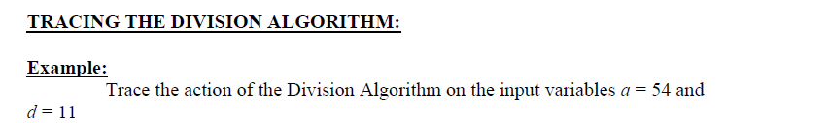

Slide 7
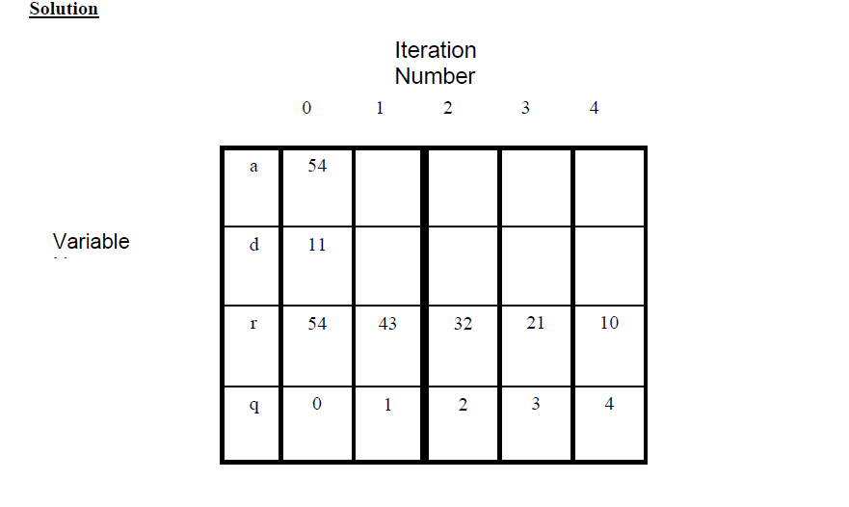

Slide 8
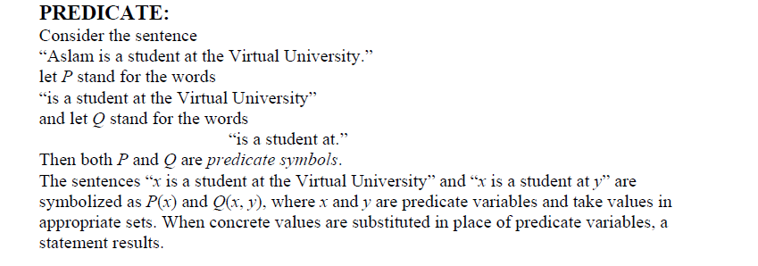

Slide 9
DEFINITION OF PREDICATE
A predicate is a sentence that contains a finite number of variables and
becomes a statement when specific values are substituted for the variables.
The domain of a predicate variable is the set of all values that may be substituted in place
of the variable.

Slide 10
PRE-CONDITIONS AND POST-CONDITIONS:
Consider an algorithm that is designed to produce a certain final state from a given state.
Both the initial and final states can be expressed as predicates involving the input and output variables.
Often the predicate describing the initial state is called the pre-condition of the algorithm and the predicate describing the final state is called the post-condition of the
algorithm

Slide 11
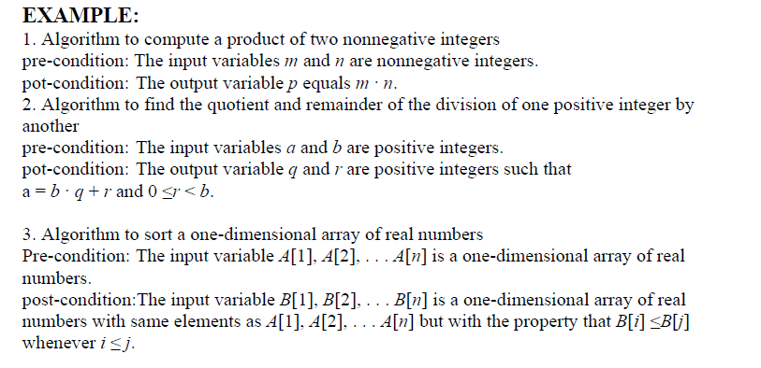

Slide 12
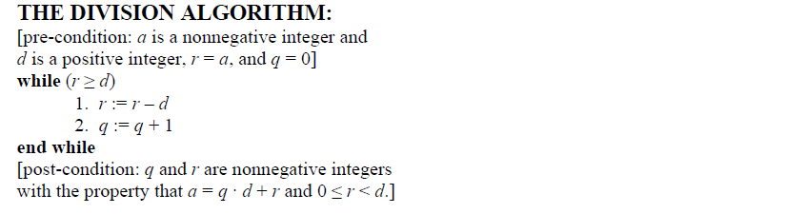

Slide 13
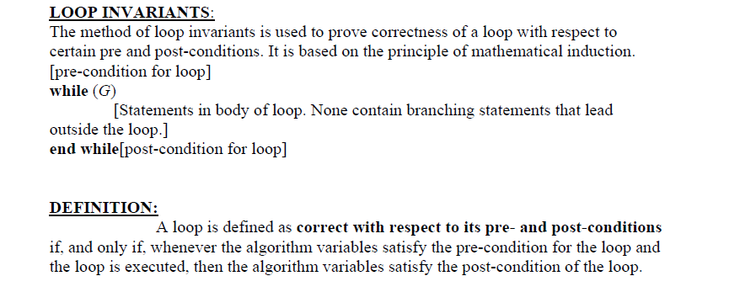

Slide 14
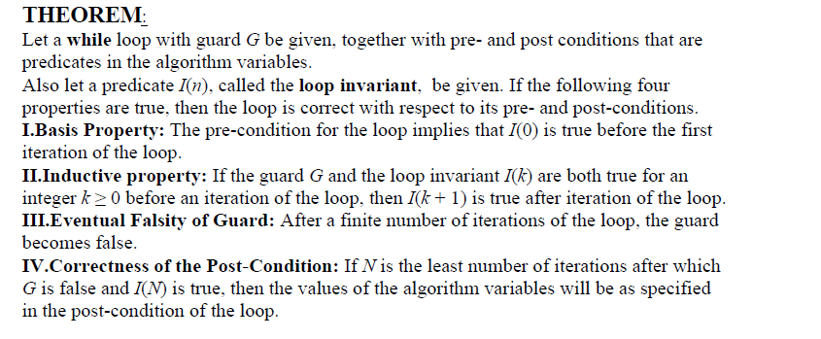

Slide 15
